Slide 1
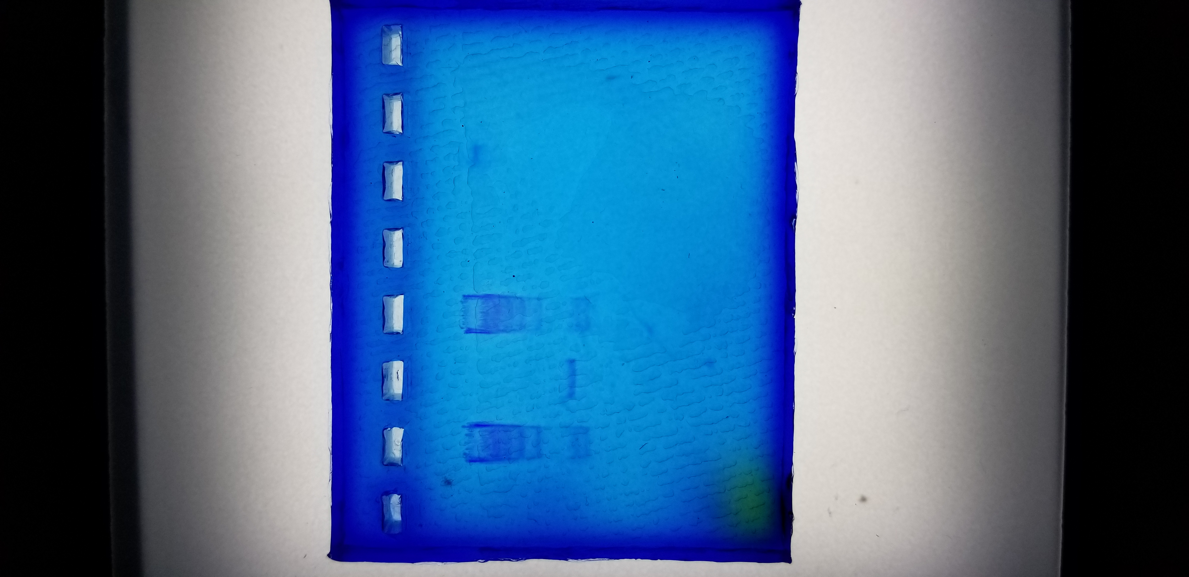
Science Express Gel Electrophoresis DNA Extension

Slide 2
This gel electrophoresis DNA extension activity assumes the “How Gel Electrophoresis Works” and “Gel Electrophoresis Dyes Lab” videos have been watched. They can be found here:
“How Gel Electrophoresis Works”: https://www.youtube.com/watch?v=mN5IvS96wNk
“Gel Electrophoresis Dyes Lab”: https://www.youtube.com/watch?v=9OEOHQDiYuw&feature=youtu.be
In this lab the Modern Biology Exp 301 “The Length of DNA Molecules” experiment was used. Since this was lab used real DNA, the agarose gel was stained with Carolina Blu stain to view the DNA bands. There are other fluorescing stains that show the DNA bands much better, but they are either cost-prohibitive are not legal to use in Indiana high schools.
This laboratory investigation uses a sample of known DNA fragment lengths to determine the length of an unknown DNA fragment length.

Slide 3
First, a 1.2% agarose gel is made. Then the gel is loaded as shown:
Lane 1: Dyes
Lane 2: Known DNA fragments
Lane 3: Unkown DNA fragment
Lane 4: Known DNA fragments
The gel was then run at 170 volts for one hour. The gel was considered complete when the some of the dyes loaded in to lane 1 started to run off of the gel. The gel was then removed from the electrophoresis chamber and placed into gel staining container and covered with Carolina Blu stain and allowed to sit for 4 hours. After 4 hours the stain was removed and the gel was de-stained with a de-stain solution for 20 minutes. Then, the gel was ready for viewing on a light box, as shown below.

Slide 4
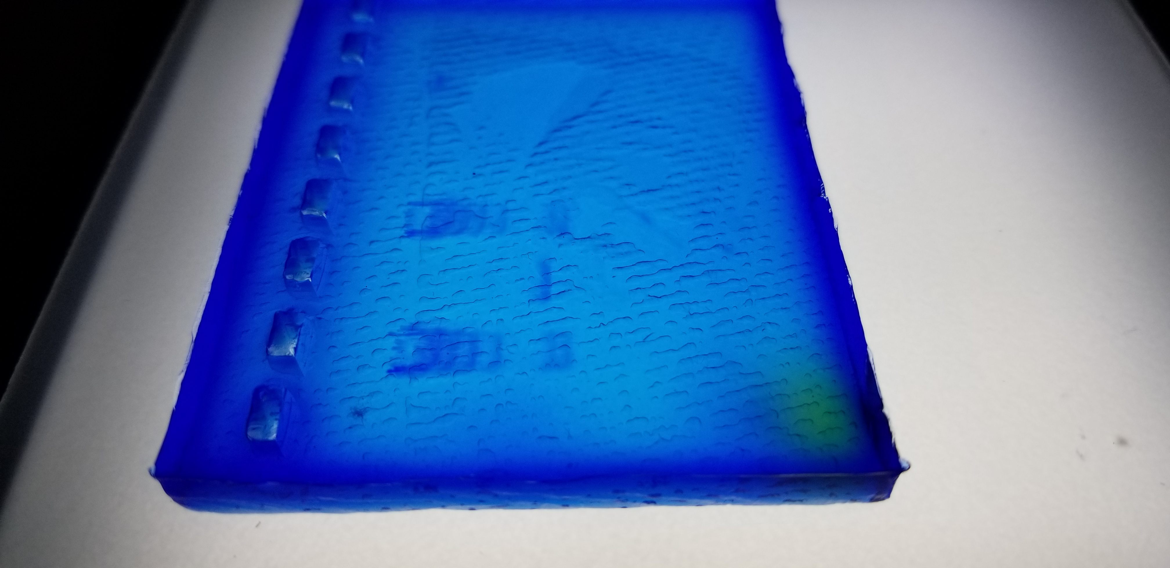
This angle shows the DNA bands better. This gel could have been run longer to get more separation, but the loading dyes included in the kit where starting run off of the gel, so it was removed from the chamber.
Unknown DNA fragment
Known DNA fragment lengths

Slide 5
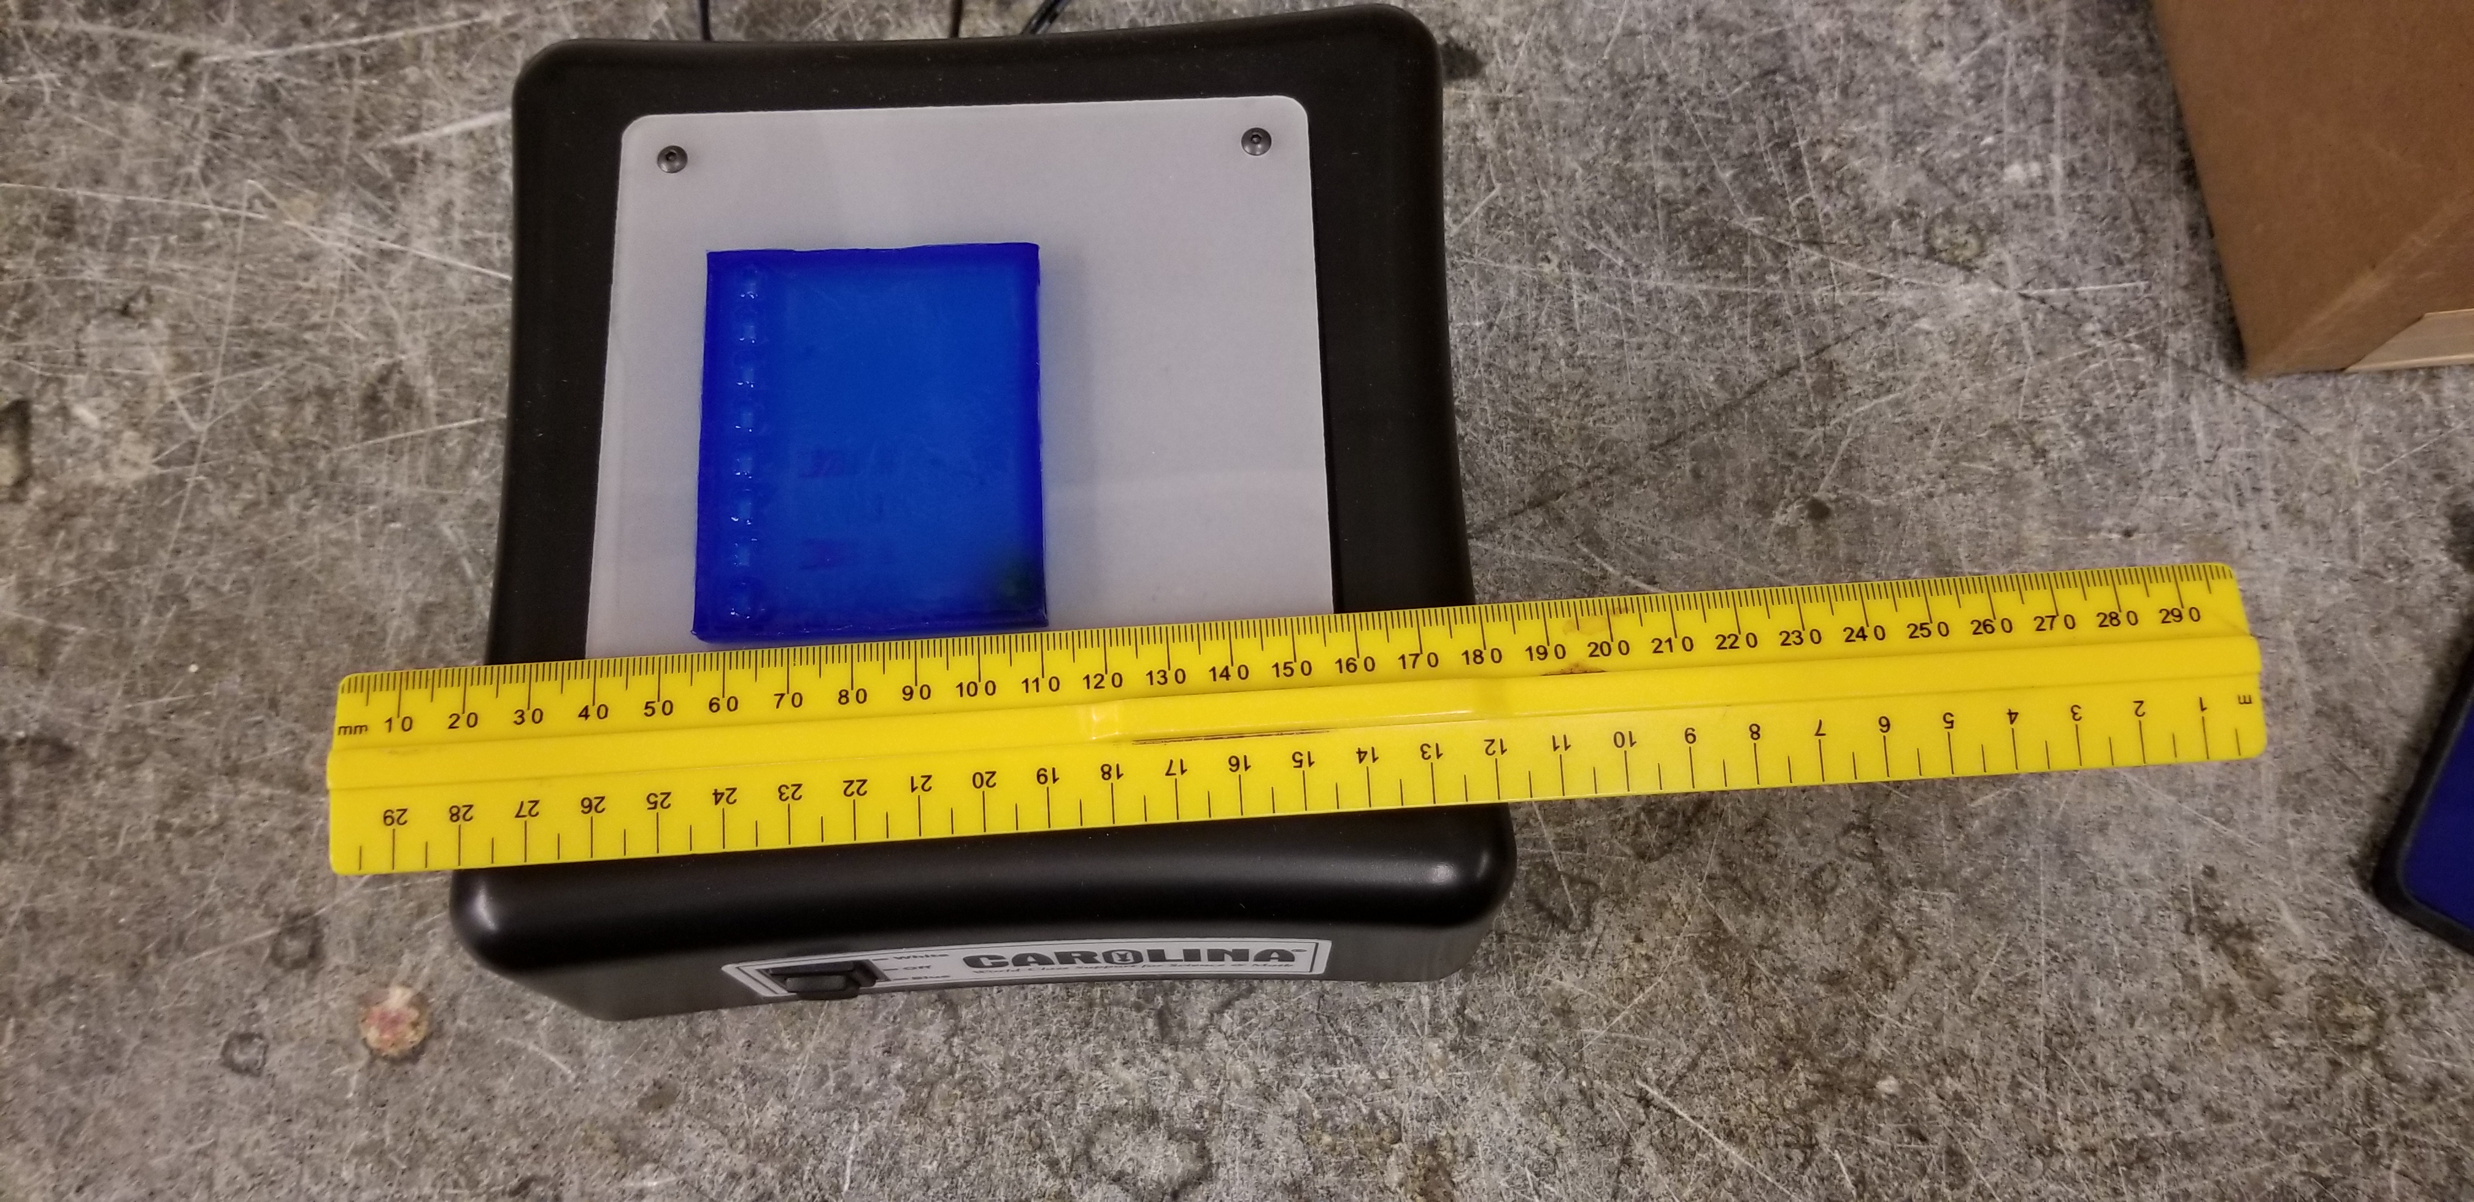
The DNA bands were then measured. The measurements were as follow:
Known DNA bands: 1) 7mm, 2) 14mm, 3) 16mm, 4) 18mm, 5) 21mm, 6) 22mm
Known DNA fragment band: 1) 20mm

Slide 6
The known DNA fragment lengths are as follows: 1 - 23.1kbp 2 – 9.4kbp 3 – 6.7kbp 4 – 4.4kbp 5 – 2.3kbp 6 – 2.0kbp

Slide 7
This activity was produced by: The Purdue University Science Express Program

